Slide 1
COMP 1451
Introduction to Software Development 2
Session 2

Slide 2
More sophisticated behavior
Using library classes to implement some more advanced functionality
5.0
Notes:
Objects First with Java
© David J. Barnes and Michael Kölling

Slide 3
Main concepts to be covered
Using library classes
Reading documentation
Objects First with Java - A Practical Introduction using BlueJ, © David J. Barnes, Michael Kölling
Notes:
Objects First with Java
© David J. Barnes and Michael Kölling

Slide 4
The Java class library
Thousands of classes.
Tens of thousands of methods.
Many useful classes that make life much easier.
Library classes are often inter-related.
Arranged into packages.
Objects First with Java - A Practical Introduction using BlueJ, © David J. Barnes, Michael Kölling
Notes:
Objects First with Java
© David J. Barnes and Michael Kölling

Slide 5
Working with the library
A competent Java programmer must be able to work with the libraries.
You should:
  know some important classes by name;
  know how to find out about other classes.
Remember:
  we only need to know the interface, not the implementation.
Objects First with Java - A Practical Introduction using BlueJ, © David J. Barnes, Michael Kölling
Notes:
Objects First with Java
© David J. Barnes and Michael Kölling

Slide 6
A Technical Support System
A textual, interactive dialog system
Idea based on ‘Eliza’ by Joseph Weizenbaum (MIT, 1960s)
Explore tech-support-complete …
Objects First with Java - A Practical Introduction using BlueJ, © David J. Barnes, Michael Kölling
Notes:
Objects First with Java
© David J. Barnes and Michael Kölling

Slide 7
Main loop structure
boolean finished = false;
while(!finished) {
do something
if(exit condition) {
finished = true;
}
else {
do something more
}
}
A common iteration pattern.
Objects First with Java - A Practical Introduction using BlueJ, © David J. Barnes, Michael Kölling
Notes:
Objects First with Java
© David J. Barnes and Michael Kölling

Slide 8
Main loop body
String input = reader.getInput();
...
String response = responder.generateResponse();
System.out.println(response);
Objects First with Java - A Practical Introduction using BlueJ, © David J. Barnes, Michael Kölling
Notes:
Objects First with Java
© David J. Barnes and Michael Kölling

Slide 9
The exit condition
String input = reader.getInput();
if(input.startsWith("bye")) {
finished = true;
}
Where does ‘startsWith’ come from?
What is it? What does it do?
How can we find out?
Objects First with Java - A Practical Introduction using BlueJ, © David J. Barnes, Michael Kölling
Notes:
Objects First with Java
© David J. Barnes and Michael Kölling

Slide 10
Reading class documentation
Documentation of the Java libraries in HTML format;
Readable in a web browser
Class API: Application Programmers’ Interface
Interface description for all library classes
Objects First with Java - A Practical Introduction using BlueJ, © David J. Barnes, Michael Kölling
Notes:
Objects First with Java
© David J. Barnes and Michael Kölling

Slide 11
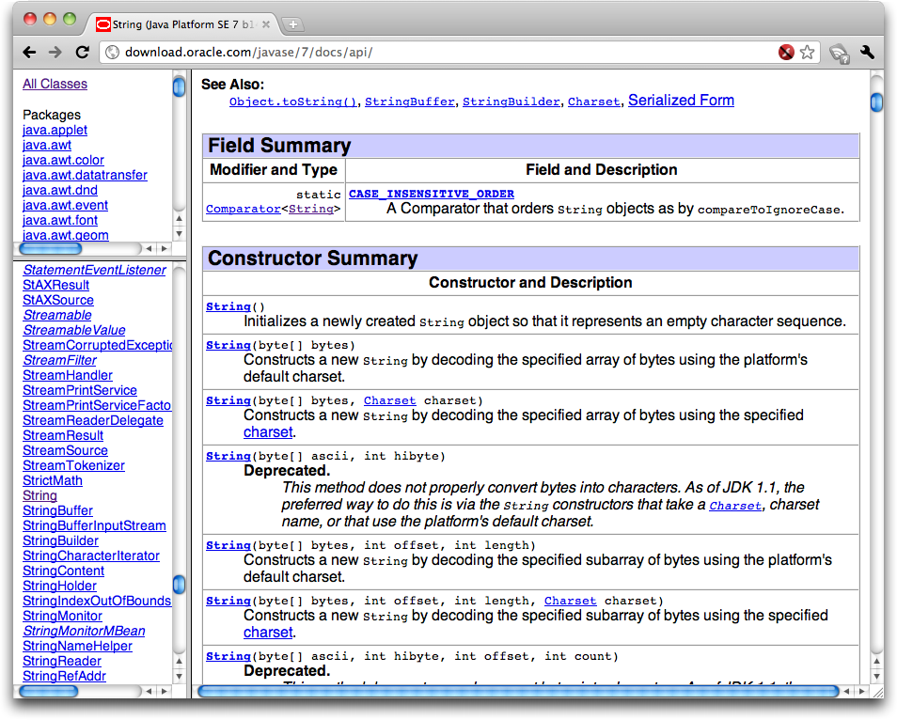
Objects First with Java - A Practical Introduction using BlueJ, © David J. Barnes, Michael Kölling

Slide 12
Interface vs implementation
The documentation includes
the name of the class;
a general description of the class;
a list of constructors and methods
return values and parameters for constructors and methods
a description of the purpose of each constructor and method
the interface of the class
Objects First with Java - A Practical Introduction using BlueJ, © David J. Barnes, Michael Kölling
Notes:
Objects First with Java
© David J. Barnes and Michael Kölling

Slide 13
Interface vs implementation
The documentation does not include
private fields (most fields are private)
private methods
the bodies (source code) of methods
the implementation of the class
Objects First with Java - A Practical Introduction using BlueJ, © David J. Barnes, Michael Kölling
Notes:
Objects First with Java
© David J. Barnes and Michael Kölling

Slide 14
Documentation for startsWith
startsWith
  public boolean startsWith(String prefix)
Tests if this string starts with the specified prefix.
Parameters:
  prefix - the prefix.
Returns:
  true if the …; false otherwise
Objects First with Java - A Practical Introduction using BlueJ, © David J. Barnes, Michael Kölling

Slide 15
Methods from String
contains
endsWith
indexOf
substring
toUpperCase
trim
Beware: strings are immutable!
Objects First with Java - A Practical Introduction using BlueJ, © David J. Barnes, Michael Kölling

Slide 16
Using library classes
Classes organized into packages.
Classes from the library must be imported using an import statement (except classes from the java.lang package).
They can then be used like classes from the current project.
Objects First with Java - A Practical Introduction using BlueJ, © David J. Barnes, Michael Kölling
Notes:
Objects First with Java
© David J. Barnes and Michael Kölling

Slide 17
Packages and import
Single classes may be imported:
import java.util.ArrayList;
Whole packages can be imported:
import java.util.*;
Importation does not involve source code insertion.
Objects First with Java - A Practical Introduction using BlueJ, © David J. Barnes, Michael Kölling
Notes:
Objects First with Java
© David J. Barnes and Michael Kölling

Slide 18
Using Random
The library class Random can be used to generate random numbers
import java.util.Random;
...
Random rand = new Random();
...
int num = rand.nextInt();
int value = 1 + rand.nextInt(100);
int index = rand.nextInt(list.size());
Objects First with Java - A Practical Introduction using BlueJ, © David J. Barnes, Michael Kölling
Notes:
Objects First with Java
© David J. Barnes and Michael Kölling

Slide 19
Selecting random responses
public Responder()
{
randomGenerator = new Random();
responses = new ArrayList<String>();
fillResponses();
}
public void fillResponses()
{
fill responses with a selection of response strings
}
public String generateResponse()
{
int index = randomGenerator.nextInt(responses.size());
return responses.get(index);
}
Objects First with Java - A Practical Introduction using BlueJ, © David J. Barnes, Michael Kölling
Notes:
Objects First with Java
© David J. Barnes and Michael Kölling

Slide 20
Parameterized classes
The documentation includes provision for a type parameter:
  ArrayList<E>
These type names reappear in the parameters and return types:
  E get(int index)
  boolean add(E e)
Objects First with Java - A Practical Introduction using BlueJ, © David J. Barnes, Michael Kölling

Slide 21
Parameterized classes
The types in the documentation are placeholders for the types we use in practice:
  An ArrayList<TicketMachine> actually has methods:
  TicketMachine get(int index)
  boolean add(TicketMachine e)
Objects First with Java - A Practical Introduction using BlueJ, © David J. Barnes, Michael Kölling

Slide 22
Review
Java has an extensive class library.
A good programmer must be familiar with the library.
The documentation tells us what we need to know to use a class (its interface).
Some classes are parameterized with additional types.
  Parameterized classes are also known as generic classes or generic types.
Objects First with Java - A Practical Introduction using BlueJ, © David J. Barnes, Michael Kölling
Notes:
Objects First with Java
© David J. Barnes and Michael Kölling

Slide 23
More sophisticated behavior
Using library classes to implement some more advanced functionality
Notes:
Objects First with Java
© David J. Barnes and Michael Kölling

Slide 24
Main concepts to be covered
Further library classes
  Set
  Map
Writing documentation
  javadoc
Objects First with Java - A Practical Introduction using BlueJ, © David J. Barnes, Michael Kölling
Notes:
Objects First with Java
© David J. Barnes and Michael Kölling

Slide 25
Using sets
import java.util.HashSet;
...
HashSet<String> mySet = new HashSet<String>();
mySet.add("one");
mySet.add("two");
mySet.add("three");
for(String element : mySet) {
do something with element
}
Compare with code for an ArrayList!
Objects First with Java - A Practical Introduction using BlueJ, © David J. Barnes, Michael Kölling
Notes:
Objects First with Java
© David J. Barnes and Michael Kölling

Slide 26
Tokenising Strings
public HashSet<String> getInput()
{
System.out.print("> ");
String inputLine =
reader.nextLine().trim().toLowerCase();
String[] wordArray = inputLine.split(" ");
HashSet<String> words = new HashSet<String>();
for(String word : wordArray) {
words.add(word);
}
return words;
}
Objects First with Java - A Practical Introduction using BlueJ, © David J. Barnes, Michael Kölling
Notes:
Objects First with Java
© David J. Barnes and Michael Kölling

Slide 27
Maps
Maps are collections that contain pairs of values.
Pairs consist of a key and a value.
Lookup works by supplying a key, and retrieving a value.
Example: a telephone book.
Objects First with Java - A Practical Introduction using BlueJ, © David J. Barnes, Michael Kölling
Notes:
Objects First with Java
© David J. Barnes and Michael Kölling

Slide 28
Using maps
A map with strings as keys and values
:HashMap
"Charles Nguyen"
"(531) 392 4587"
"Lisa Jones"
"(402) 536 4674"
"William H. Smith"
"(998) 488 0123"
Objects First with Java - A Practical Introduction using BlueJ, © David J. Barnes, Michael Kölling
Notes:
Objects First with Java
© David J. Barnes and Michael Kölling

Slide 29
Using maps
HashMap <String, String> phoneBook =
new HashMap<String, String>();
phoneBook.put("Charles Nguyen", "(531) 9392 4587");
phoneBook.put("Lisa Jones", "(402) 4536 4674");
phoneBook.put("William H. Smith", "(998) 5488 0123");
String phoneNumber = phoneBook.get("Lisa Jones");
System.out.println(phoneNumber);
Objects First with Java - A Practical Introduction using BlueJ, © David J. Barnes, Michael Kölling
Notes:
Objects First with Java
© David J. Barnes and Michael Kölling

Slide 30
List, Map and Set
Alternative ways to group objects.
Varying implementations available:
  ArrayList, LinkedList
  HashSet, TreeSet
But HashMap is unrelated to HashSet, despite similar names.
The second word reveals organizational relatedness.
Objects First with Java - A Practical Introduction using BlueJ, © David J. Barnes, Michael Kölling

Slide 31
Writing class documentation
Your own classes should be documented the same way library classes are.
Other people should be able to use your class without reading the implementation.
Make your class a potential 'library class'!
Objects First with Java - A Practical Introduction using BlueJ, © David J. Barnes, Michael Kölling
Notes:
Objects First with Java
© David J. Barnes and Michael Kölling

Slide 32
Elements of documentation
Documentation for a class should include:
the class name
a comment describing the overall purpose and characteristics of the class
a version number
the authors’ names
documentation for each constructor and each method
Objects First with Java - A Practical Introduction using BlueJ, © David J. Barnes, Michael Kölling
Notes:
Objects First with Java
© David J. Barnes and Michael Kölling

Slide 33
Elements of documentation
The documentation for each constructor and method should include:
the name of the method
the return type
the parameter names and types
a description of the purpose and function of the method
a description of each parameter
a description of the value returned
Objects First with Java - A Practical Introduction using BlueJ, © David J. Barnes, Michael Kölling
Notes:
Objects First with Java
© David J. Barnes and Michael Kölling

Slide 34
javadoc
Class comment:
/**
* The Responder class represents a response
* generator object. It is used to generate an
* automatic response.
*
* @author Michael Kölling and David J. Barnes
* @version 1.0 (2011.07.31)
*/
Objects First with Java - A Practical Introduction using BlueJ, © David J. Barnes, Michael Kölling
Notes:
Objects First with Java
© David J. Barnes and Michael Kölling

Slide 35
javadoc
Method comment:
/**
* Read a line of text from standard input (the text
* terminal), and return it as a set of words.
*
* @param prompt A prompt to print to screen.
* @return A set of Strings, where each String is
* one of the words typed by the user
*/
public HashSet<String> getInput(String prompt)
{
...
}
Objects First with Java - A Practical Introduction using BlueJ, © David J. Barnes, Michael Kölling
Notes:
Objects First with Java
© David J. Barnes and Michael Kölling

Slide 36
Public vs private
Public elements are accessible to objects of other classes:
  Fields, constructors and methods
Fields should not be public.
Private elements are accessible only to objects of the same class.
Only methods that are intended for other classes should be public.
Objects First with Java - A Practical Introduction using BlueJ, © David J. Barnes, Michael Kölling
Notes:
Objects First with Java
© David J. Barnes and Michael Kölling

Slide 37
Information hiding
Data belonging to one object is hidden from other objects.
Know what an object can do, not how it does it.
Information hiding increases the level of independence.
Independence of modules is important for large systems and maintenance.
Objects First with Java - A Practical Introduction using BlueJ, © David J. Barnes, Michael Kölling
Notes:
Objects First with Java
© David J. Barnes and Michael Kölling

Slide 38
Code completion
The BlueJ editor supports lookup of methods.
Use Ctrl-space after a method-call dot to bring up a list of available methods.
Use Return to select a highlighted method.
Objects First with Java - A Practical Introduction using BlueJ, © David J. Barnes, Michael Kölling

Slide 39
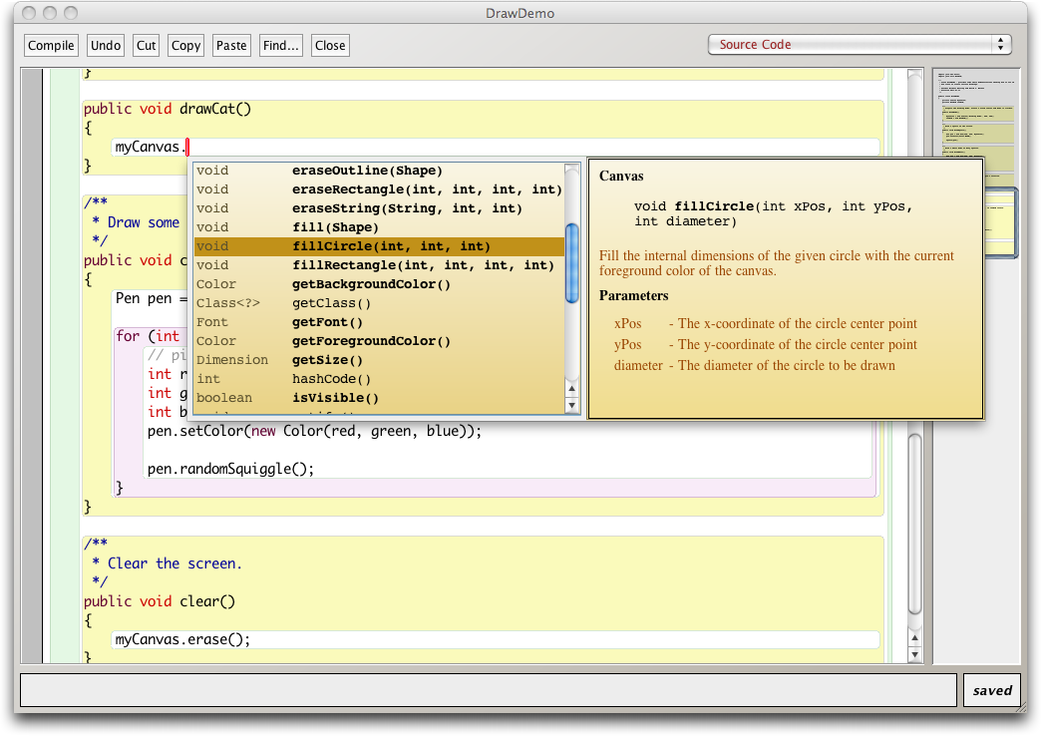
Code completion in BlueJ
Objects First with Java - A Practical Introduction using BlueJ, © David J. Barnes, Michael Kölling

Slide 40
Review
Java has an extensive class library.
A good programmer must be familiar with the library.
The documentation tells us what we need to know to use a class (interface).
The implementation is hidden (information hiding).
We document our classes so that the interface can be read on its own (class comment, method comments).
Objects First with Java - A Practical Introduction using BlueJ, © David J. Barnes, Michael Kölling
Notes:
Objects First with Java
© David J. Barnes and Michael Kölling

Slide 41
Class and constant variables
Objects First with Java - A Practical Introduction using BlueJ, © David J. Barnes, Michael Kölling

Slide 42
Class variables
A class variable is shared between all instances of the class.
In fact, it belongs to the class and exists independent of any instances.
Designated by the static keyword.
Public static variables are accessed via the class name; e.g.:
  Thermometer.boilingPoint
Objects First with Java - A Practical Introduction using BlueJ, © David J. Barnes, Michael Kölling

Slide 43
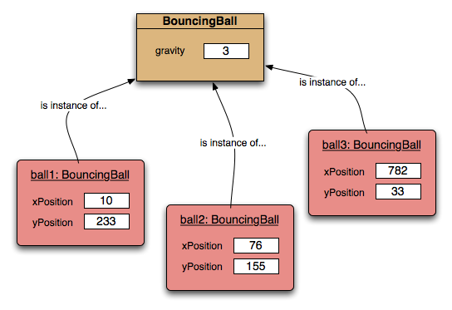
Class variables
Objects First with Java - A Practical Introduction using BlueJ, © David J. Barnes, Michael Kölling
Notes:
Objects First with Java
© David J. Barnes and Michael Kölling

Slide 44
Constants
A variable, once set, can have its value fixed.
Designated by the final keyword.
  final int max = list.size();
Final fields must be set in their declaration or the constructor.
Combing static and final is common.
Objects First with Java - A Practical Introduction using BlueJ, © David J. Barnes, Michael Kölling

Slide 45
Class constants
static: class variable
final: constant
private static final int gravity = 3;
Public visibility is less of an issue with final fields.
Upper-case names often used for class constants:
public static final int BOILING_POINT = 100;
Objects First with Java - A Practical Introduction using BlueJ, © David J. Barnes, Michael Kölling
Notes:
Objects First with Java
© David J. Barnes and Michael Kölling

